Slide 1





⥫
Enhancing Digit Recognition Through Generative Adversarial Networks
PRESENTED BY: ASWIN DHURAI C
REG_NO: 962821104017
DEPT: Computer Science and Engineering
NM_ID: au962821101017
EMAIL_ID: aswindhurai01@gmail.com

Slide 2





Introduction
Digit recognition is a fundamental task in the field of computer vision, with applications ranging from handwritten digit recognition for postal services to automated processing of forms and documents.
Traditional methods for digit recognition often rely on supervised learning techniques such as convolutional neural networks (CNNs). However, with the emergence of Generative Adversarial Networks (GANs), new avenues for improving digit recognition have opened up

Slide 3






The primary objective is to leverage the power of GANs to generate synthetic digit images that closely resemble real digits from a dataset such as MNIST.
Problem Statement
By incorporating these synthetic images into the training data, we aim to augment the dataset and improve the performance of digit recognition models

Slide 4

Problem Overview: Data Limitations: Traditional digit recognition methods heavily rely on labeled datasets for training, which can be limited in size and diversity. This can lead to challenges in achieving robust performance. Robustness and Generalization: Existing digit recognition models may struggle to generalize well to unseen data or handle variations in input, such as different handwriting styles or orientations.

Slide 5
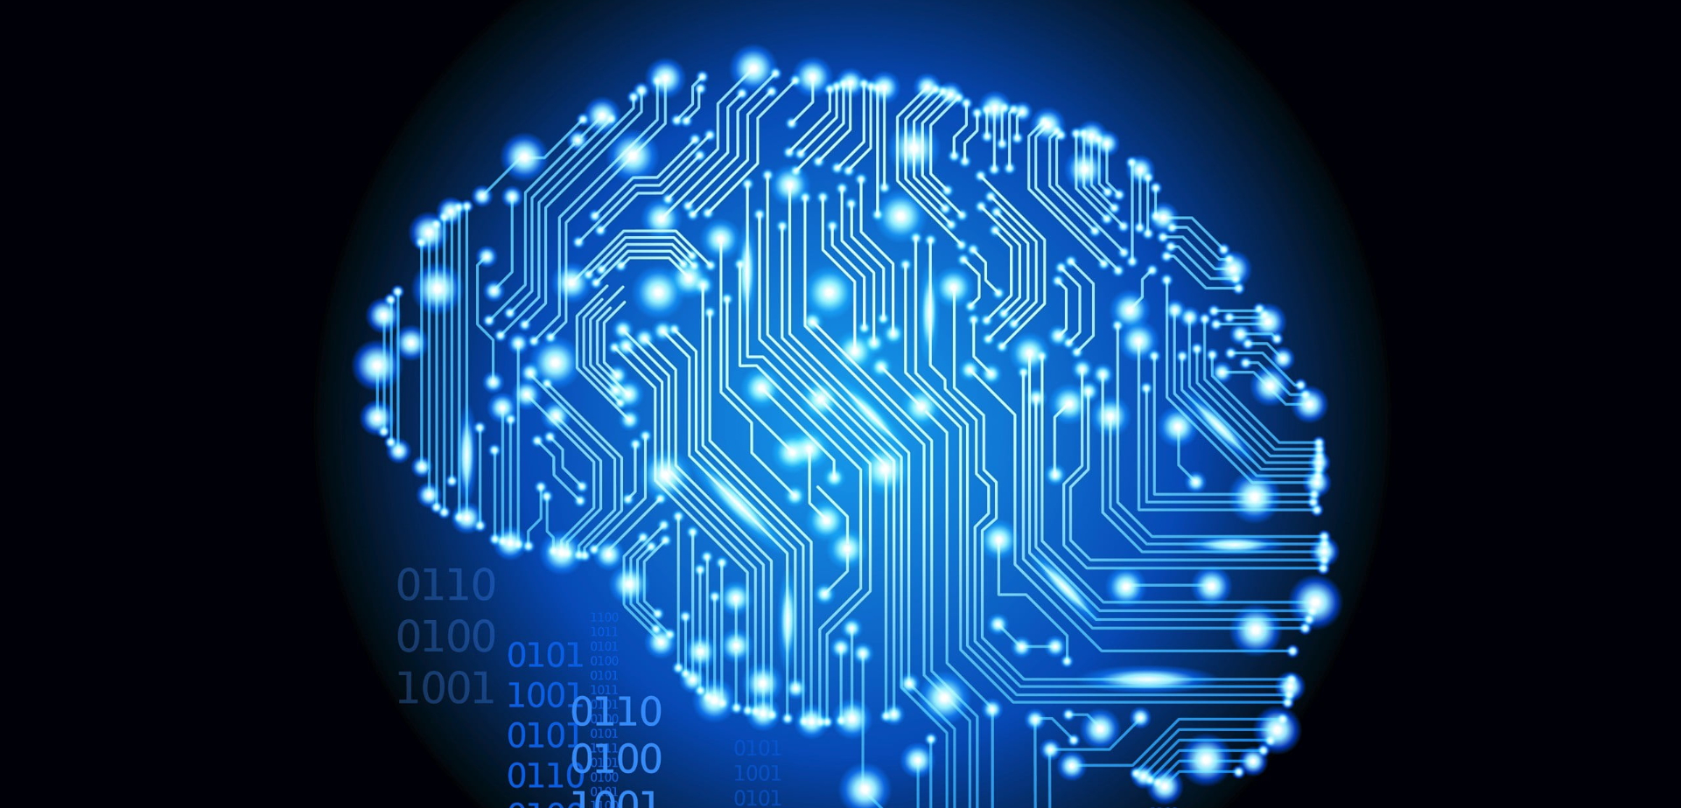




Problem Modelling: Problem Definition: Define the objective of digit recognition using GANs, such as improving the performance and robustness of digit recognition models by generating synthetic digit images. Data Collection and Preprocessing: Gather a dataset of real digit images, such as the MNIST dataset, which contains labeled handwritten digit images. Preprocess the data by resizing, normalizing, and converting it into a format suitable for training GANs. Training the GAN: Train the GAN on the real digit images dataset. The generator learns to generate realistic-looking digit images, while the discriminator learns to differentiate between real and fake images. This involves an adversarial training process where the generator and discriminator networks compete against each other.

Slide 6
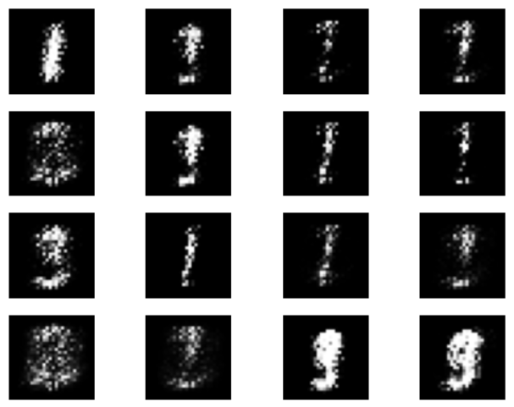
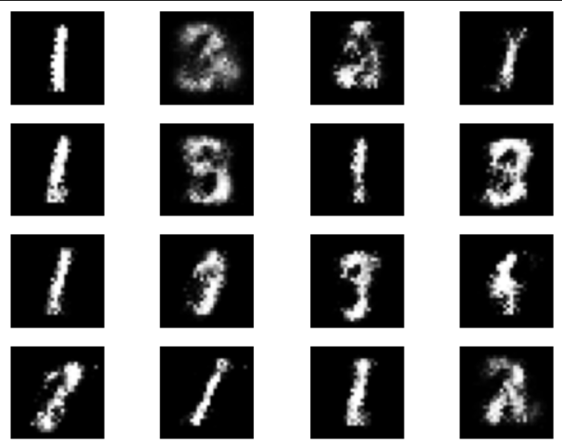
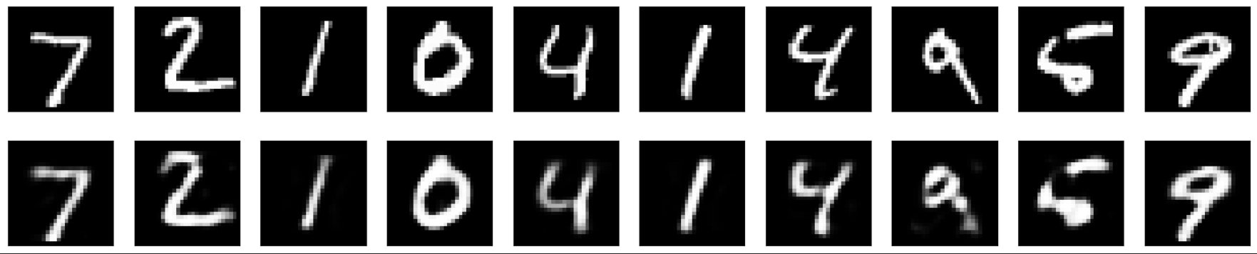
RESULT:

Slide 7




Conclusion:
In conclusion, digit recognition using Generative Adversarial Networks (GANs) presents a promising approach to address the challenges faced by traditional methods in the field. Through the generation of synthetic digit images, GANs offer a means to augment datasets, improve model performance, and enhance the robustness of digit recognition systems.

Slide 8











ThanKs!

